Slide 1

Microservices
Fabian Wohlschläger
02/21/2019
Notes:
SPEAKER NOTES:
This slide deck may support educating the customers about Microservices. The target audience are customer architects and their senior engineers (Level 300/400). It is mostly cloud agnostic, but Microsoft Azure can help a lot managing all this moving pieces. Microservices itself are quiet useful during app modernization and cloud migration. Mastering microservices requires a high degree of automation, so additional education in Azure DevOps might be a possible follow-up to this presentation. Finally looking into container orchestrators like Azure Kubernetes Service or Service Fabric will also be required for adopting microservices in an efficient manner.

Slide 2
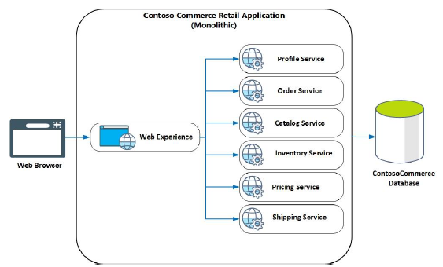
Recap: Monoliths
Services implement multiple business concerns
Services communicate with a single database
Application affected by single database schema change
Services are packaged and deployed as a single unit
Service change requires application redeployment
Application can only be scaled as a whole
Unstable service can bring whole application down
Notes:
SPEAKER NOTES:
In order to better understand the microservices, someone also has to understand the characteristics of monoliths and see how they differ. Monoliths basically are packaged and deployed as a single unit, implementing multiple business concerns. In contrast, microservices split this business concerns on multiple packaged and deployable units. As we will see, microservices are no silver bullet. There are use cases for microservices and for monoliths as well.

Slide 3
Microservices
Definition
The microservice architectural style is an approach to developing a single application as a suite of small services, each running in its own process and communicating with lightweight mechanisms, often an HTTP resource API. These services are built around business capabilities and independently deployable by fully automated deployment machinery. There is a bare minimum of centralized management of these services, which may be written in different programming languages and use different data storage.
“
”
- James Lewis & Martin Fowler
Notes:
SPEAKER NOTES:
There are many definitions for microservices, so we just picked the most prominent one by James Lewis and Martin Fowler. Generally speaking, microservices follow a rather holistic approach so they can evolve individually, basically by aligning business, services and team boundaries. Since microservices are independent to each other with no need for central management, they can also be managed and scaled individually. This especially helps you when scaling towards multiple distributed teams, which is one of the main use cases for microservices.

Slide 4
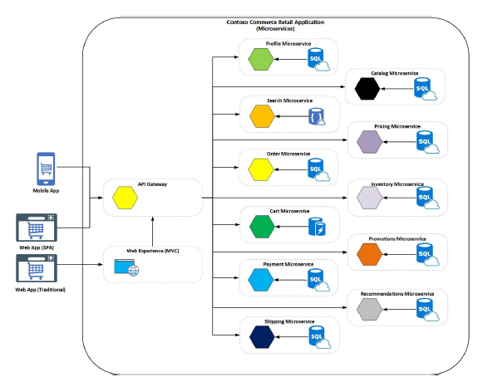
Characteristics
Services implement single business or technical concern (single responsibility principle)
Services are developed, deployed and scaled individually
Services run in their own processes and/or containers
Each service has its own data repository
Clients access the services through well-defined APIs managed by API Gateway
Notes:
SPEAKER NOTES:
This details the previous slides and highlights the microservices characteristics. This slides can be seen in contrast to the slide about monoliths. While monoliths implement multiple business concerns, each microservices implement a single business or technical concern. In order to develop, deploy and scale each microservice individually, microservices run in their own process/container and have their own data repository. Finally highlight that you also require some infrastructure pieces like API Gateways and container orchestrators, which Azure can provide you out of the box.

Slide 5
Benefits
Independent development
Independent deployments
Small, focused teams
Mixed technology stacks
Fault isolation
Granular scaling
Notes:
SPEAKER NOTES:
Microservices were vastly adopted, since they come also with a lot of benefits. They might enable other best practices i.e. doing DevOps with a large monolith might be quiet challenging. Microservices are much smaller and independently deployable, so DevOps adoption is much easier. Better have many speed boats compared to a large tanker. Also mixing technology stacks is quiet common these days, i.e. some AI/ML experts can write some custom machine learning and expose it as a microservice. The consuming engineering teams do not have to know machine learning at all, they just consume the microservice via a convenient API. That’s what Microsoft internally did for instance with the Cognitive Services, but also Azure DevOps is built on top of microservices.

Slide 6
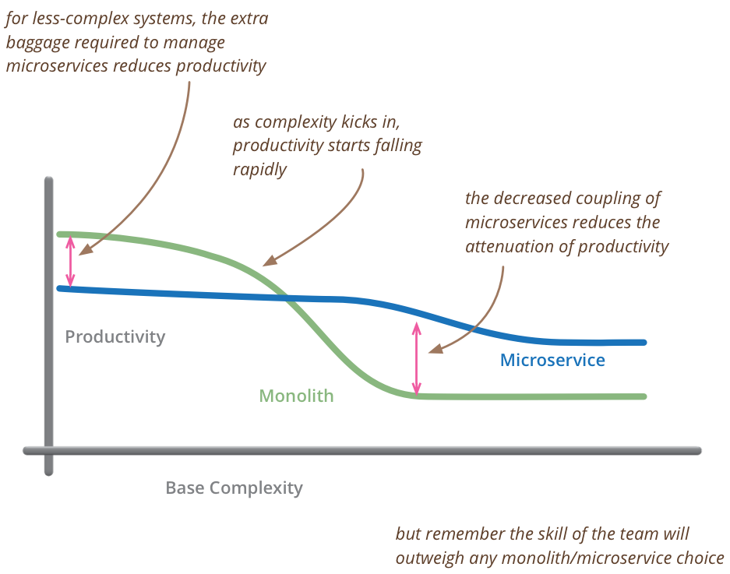
Challenges
Operational Complexity
Service boundaries
Data consistency & integrity
Service discovery
Network congestion & latency
DevOps
- Martin Fowler
Notes:
SPEAKER NOTES:
As we will see, microservices are no silver bullet. They come with a lot of operational complexity to master. Basically there is a break even, when it is worth to use microservices over monoliths – see graph on the right. When adopting microservices, the challenges listed must be individual addressed and we will talk about them in a minute. That’s why Azure is a great choice for hosting microservices, considering most of the required capabilities are provided out of the box. Take for instance Azure DevOps, which greatly helps you automating your deployment. Container orchestrators like Azure Kubernetes Service also help to shift the complexity barrier to the left. Both also work quiet well with Azure Monitoring, so you always know what is going on within your microservices. In contrast imagine doing microservices on premise using virtual machines., which requires a lot of additional engineering on top of them.

Slide 7
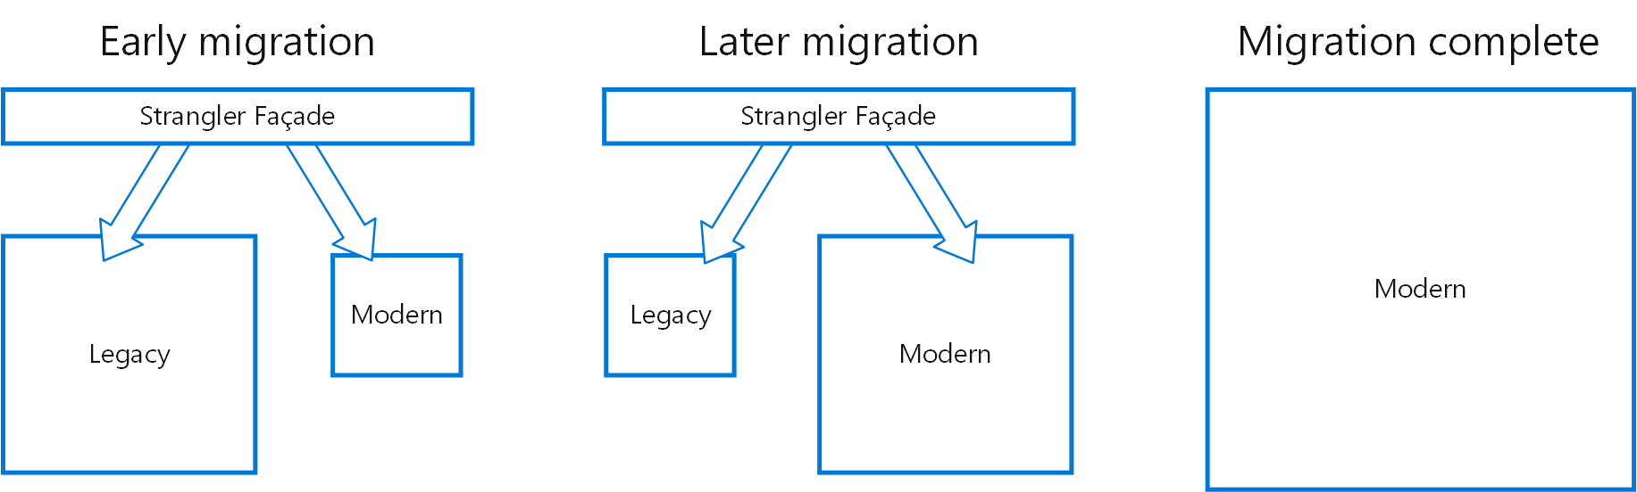
Breaking up the monolith
Strangler pattern
Notes:
SPEAKER NOTES:
Basically there are two approaches to adopt microservices – starting green-field or brown-field. Green-field refers to adopting microservices when developing a new application from scratch. Very common is also adopting microservices during app modernization of an existing application – the so called brown-field approach. You cannot move a legacy monolithic app to a microservices approach at once - you have to do it step by step. Use a Strangler Façade to provide a stable interface to the client, while you do the migration. Basically the client should not know if it talks to the legacy app or to the modern microservices. Slowly extract and move bits of your legacy app into your modern microservices with the Strangler Façade redirecting the client calls. When everything is shifted over to the modern microservices architecture, just remove the Strangler Façade and you are done.

Slide 8
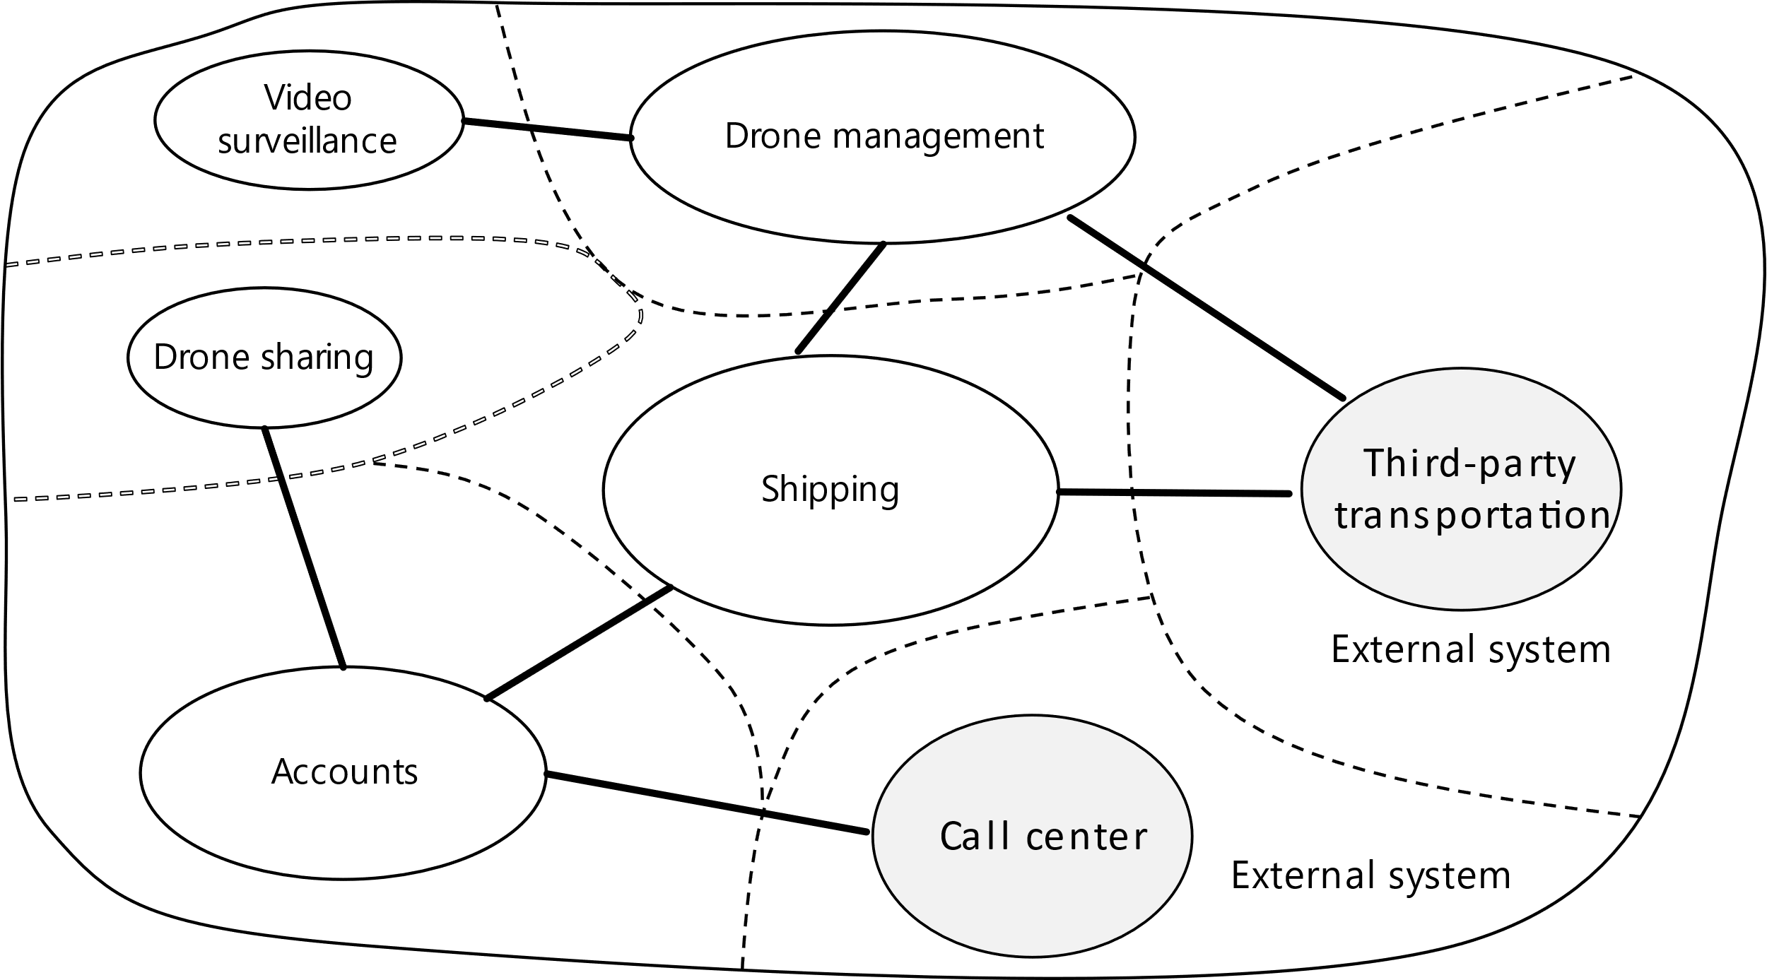
Service boundaries
Analyze domain
Define bounded contexts
Define entities, aggregates & services
Identity microservices
“
A bounded context is simply the boundary within a domain where a particular domain model applies.
”
- Domain-driven Design by Eric Evans
Notes:
SPEAKER NOTES:
As stated previously, microservices follow a rather holistic approach so they can evolve individually, basically by aligning business, services and team boundaries. But how to identify the business boundaries? How can you derive the service boundaries from them? This is where the well-established Domain-driven Design or short DDD by Eric Evans comes into play. With DDD you first identify sub domain within your business domains, the so-called bounded context. Take an e-commerce application for instance: Ordering, shipping, catalogue, etc. Usually you talk to different domain experts, each one using their own language. This deferent domain experts and their languages or so-called ubiquitous language are good indicators for bounded contexts. A microservice itself should not span more than one bounded context, since bounded contexts should evolve independently. If the bounded context is still too big, take a look into other DDD concepts like aggregates and domain services as well. You can find more detailed information about them in the links provided at the end. We will not go into detail here since you can fill easily a whole presentation about DDD. There are also alternatives to using DDD. Event-storming invented by Alberto Brandolini is also a quiet common technique to better understand your business boundaries. Finally encapsulating non-functional requirements like authentication in a separate microservice makes a lot of sense as well.

Slide 9
Team boundaries
Organizations which design systems are constrained to produce designs which are copies of the communication structures of these organizations.
“
”
- Melvin E. Conway
Fine-grained communication required for developing a single microservice, following choose small co-located team who owns a microservice („2 pizza team“)
Coarse-grained communication desired between loosely coupled teams in order to scale, following no requirement for co-location but for stable and versioned APIs
Align domain, service and team boundaries
Notes:
SPEAKER NOTES:
So we aligned the service boundaries to the business boundaries, but what about the team structure. Melvin E. Conway formulated a law named after him to outline the implications of organizations and their communication structure on the product designs they produce. Co-located teams tend to couple their product more, since they can communicate frequently and often. Split teams try to agree on stable APIs, since they cannot communicate in a so fine-grained fashion. This principle can be leveraged when developing microservices. While you want coarse-grained communication via stable APIs between microservices, you want fine-grained communication within your microservices since you interact on code-level. Following let a co-located team own a microservice and only them, with other teams located anywhere only use stable and versioned APIs to use this microservice. As a result, we aligned domain, service and team boundaries, which is quiet powerful to evolve these microservices and their bounded context individually.

Slide 10

Interservice communication
Synchronous Communication
Synchronous communication. In this pattern, a service calls an API that another service exposes, using a protocol such as HTTP or gRPC. This option is a synchronous messaging pattern because the caller waits for a response from the receiver. Typically RESTful APIs are external-facing or exposed towards the UI. Callers must implement retry and timeouts for resiliency. APIs must be semantically versioned.
UI
Synchronous
Asynchronous Communication
Asynchronous message passing. In this pattern, a service sends messages without waiting for a response, and one or more services process the message asynchronously. Typically inter-service communication is implemented via asynchronous messaging using AMQP or similar protocols. Resilience is built into the underlying service bus, which follows the paradigm “smart endpoints and dump pipes”. Messages must be semantically versioned.
Service Bus
Asynchronous
Notes:
SPEAKER NOTES:
Let’s make an analogy when comparing synchronous to asynchronous communication. Synchronous communication is like paying with your credit card. You insert your card, input your PIN and wait for the transaction to be approved. In contrast, Asynchronous communication is non-blocking. It is more like ordering a pizza. You order it online and, at some point in time you get it delivered. While you could let microservices interact with each other using only synchronous HTTP-based REST APIs, this might not be desirable. For instance think of downstream calls: Microservice A calls Microservice B, which then calls Microservice C and fails. How can you rollback and compensate this business transactions? Also think about availability and scalability. With synchronous communication the sender always waits for a response. If the receiver is temporarily not available, you have a problem. Also you basically block a thread on the sender and the receiver side, which obviously has some hardware-based limitations. Reliability, scalability and error handling using dead-letter queues is where asynchronous communication typically shines. Following leverage synchronous communication on the UI side of things where waiting is desired. Between the microservices use asynchronous communication. If that does not work for you, you might want to reconsider your business and service boundaries.

Slide 11
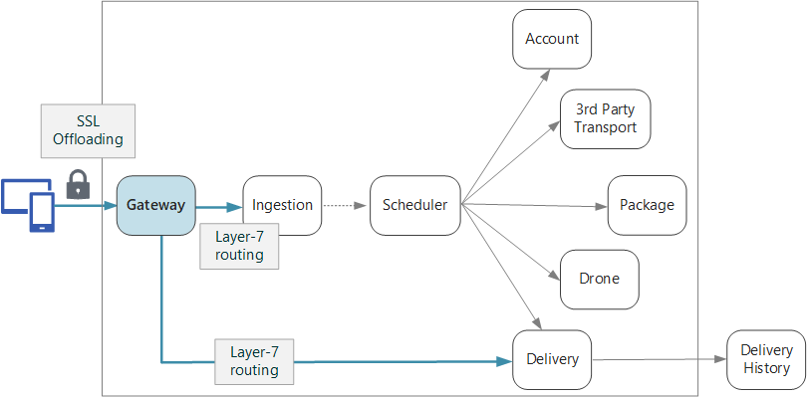
API gateways
Gateway Routing
Gateway Offloading
Authentication
SSL termination
IP whitelisting
Client throttling
Logging & monitoring
Web application firewall
Gateway Aggregation
Notes:
SPEAKER NOTES:
Some cross-cutting concerns are required for all microservices, i.e. authentication, SSL termination and client throttling. You do not want the management burden and let each microservice provide their own implementation of this cross-cutting concern. Better offload these concerns to a central gateway component so you can change them easily. This so-called API gateways also might help you with routing your request to the right microservice. Especially in mobile scenarios, you might want to also aggregate responses of microservices, just to take mobile network latency into consideration.

Slide 12
Workflows
Send
Subscribe
Publish
Event
Orchestration
Choreography
Less coupling
More transparency
Notes:
SPEAKER NOTES:
Let’s talk about workflows. Workflows typically span multiple microservices, but also include a certain state to indicate its progress. You might use a dedicated workflow engine and perform orchestration, similar to the director of an orchestra. While this provides you great transparency about the progress, it also comes with a certain coupling. If less coupling is more desirable use choreography, which implicitly creates a workflow using an event-driven approach.

Slide 13
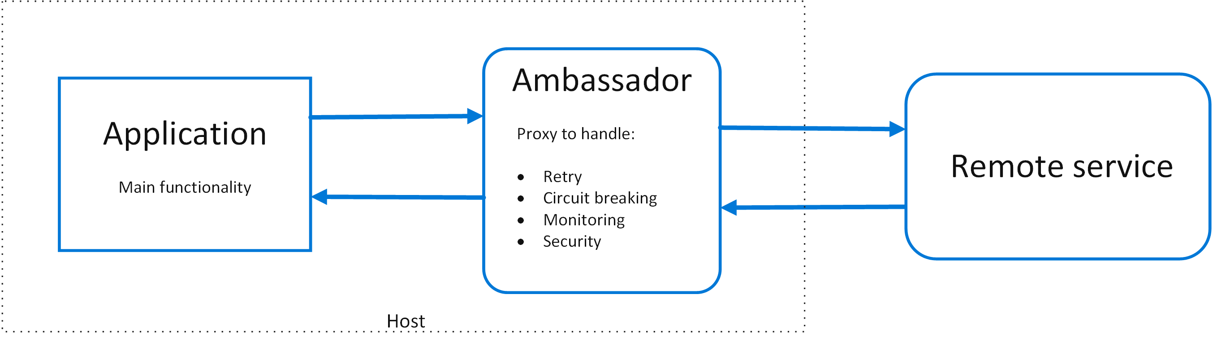
External systems
Ambassador pattern
Notes:
SPEAKER NOTES:
Usually a microservice-based system does not stand for its own, it might talk to mainframes, invoke some external REST services etc. As stated, we desire asynchronous communication between the microservices to especially guarantee a certain reliability and error handling. As a solution you could plugin a proxy service in between your microservice and the remote service, the so-called Ambassador. The Ambassador provides you the capabilities the remote service is missing and also allows you to encapsulate its communication details.

Slide 14
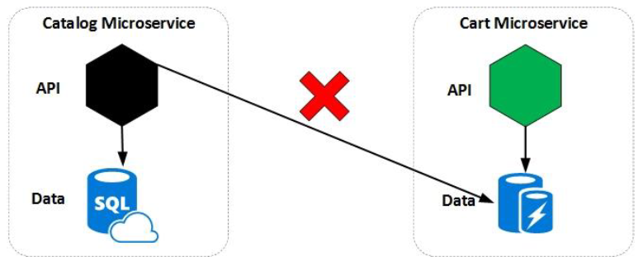
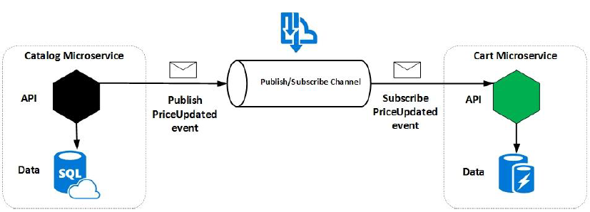
Data considerations
Every service manages its own data
No sharing of data stores between services
Profit from polyglot persistence
Service might represent the source of truth for a given entity («master»)
Other services might hold a subset of the entity
Embrace eventual consistency (no distributed transactions)
Notes:
SPEAKER NOTES:
Data is one of the trickiest parts when embracing a microservice-based architecture. Every microservice manages its own data store, so there is no sharing of data stores between services. Some services might represent the source of truth for a given entity (“master”), while others might hold a subset of the entity. Takes for instance an e-commerce application. Probably there will be some user management microservice connected to a CRM system. Other microservices might also require part of the user data, i.e. the users name and shipping address are required in the shipping microservice. As stated previously, microservices should use asynchronous communication to talk to each other. So you could easily publish changes from the user management service (“master”) and subscribe from the shipping microservice. Basically embracing eventual consistency, which scales quiet well within distributed systems. Also you might embrace polyglot persistence using different data stores for different purposes, i.e. graphs, documents, etc.

Slide 15
Reporting
Versioned & deployed together
Data pump
Change event
Microservice
Reporting System
Microservice
Reporting System
Data Pump
Event Data Pump
Notes:
SPEAKER NOTES:
As previously stated, every microservice manages its own data store, so there is no sharing of data stores between services. But there is one exception. Reporting systems need to aggregate the data in order to provide meaningful insights. Best practice here is to use data pumps, which are provided by the teams managing their microservices. When a change is required in a microservice, the corresponding team is also responsible for updating the data pump. Following the microservice and the data pump should also be versioned and deployed together. Every microservice might have a corresponding database schema in the reporting system, which itself uses materialized views for data aggregation. As stated previously, microservices should use asynchronous communication to talk to each other. Event data pumps is a flavor of data pumps, which leverage asynchronous communication to propagate change events to the reporting system. This approach is very similar to the one described for data replication in the previous slide about data considerations. Event data pumps allow even more loose coupling then traditional data pumps, but also provide less throughput. Again there is no silver bullet, you just have to decide what you want to optimize for.

Slide 16
UX/UI
UI
UI
UI
UI
UI Shell
UI
UI
UI
Menu, Stylesheets
Single UI
Multiple UIs
Composite UI
Notes:
SPEAKER NOTES:
When splitting systems into multiple microservices there are, generally speaking, 3 choices for managing the UX/UI. One option would be to have just a single UI, which calls the microservices via REST APIs. This approach provides the greatest alignment in terms of UX/UI, but also makes the UI dependent to all microservices. You can mitigate the problem by properly versioning the REST APIs, e.g. using semantic versioning. Another approach might be that every microservices provides its own UI, resulting in multiple UIs or web apps. The menu and stylesheets would be centrally provided by another microservice. Having multiple UIs provides you with the greatest independency, but also makes alignment of UX/UI difficult. Usually it makes sense for very large UIs, which can be separated on a more coarse-grained level. A good example are large tax forms, which you develop for one tax year and unlikely change often. A mixed approach would be to develop a composite UI. Centrally only a UI Shell is provided. This UI Shell is basically a skeleton to add web components provided by different microservices. Since this web components are all embedded in the UI Shell, things like having a unified UI/UX become much easier.

Slide 17
DevOps
DevOps is the union of people, process, and technology to enable continuous delivery of value to customers. DevOps, a compound of dev (development) and ops (operations), is a software development practice that unifies development and IT operations. The meaning signifies coordination and collaboration among formerly siloed disciplines. Quality engineering and security teams also become part of the broader team in the DevOps model.
Continuous Integration (CI)
Improve software development quality and speed.
When you use Azure Pipelines or Jenkins to build apps in the cloud and deploy to Azure, each time you commit code, it’s automatically built and tested, and bugs are detected faster.
Continuous Deployment (CD)
By combining continuous integration and infrastructure as code (IaC), you’ll achieve identical deployments and the confidence to deploy to production at any time.
With continuous deployment, you can automate the entire process from code commit to production if your CI/CD tests are successful.
Continuous Learning & Monitoring
With Azure Application Insights you can identify how your applications are performing and test if the recent deployment made things better or worse.
Using CI/CD practices, paired with monitoring tools, you’ll be able to safely deliver features to your customers as soon as they’re ready.
Notes:
SPEAKER NOTES:
Mastering microservices requires a high degree of automation, so DevOps is a key skill to master. Continuously integrate your code base and especially embrace automatic testing. Automatically and constantly release your microservices following the best practice of Continuous Deployment. Better have many small deployments than one large one most likely to fail. Things like testing in production may relieve you from the burden of test data management, which gets quiet complicated in every distributed system. Use continuous learning and monitoring to gain fast feedback if your changes work in production.

Slide 18
Testing
Manual
End-to-End (UI, Sec, Perf)
Confidence
Change Resistence
Faster Feedback
Automated
Service
Unit
Test Pyramid
Notes:
SPEAKER NOTES:
One of the more well-known models in the test automation world is the Test Pyramid. It outlines how a well-structured test suite looks like, based on the application layers being tested. While unit tests usually focus on the smaller units like classes containing business logic, service tests are testing the integration of the classes within a microservice including its data store. Some tests require a more end-to-end scope involving many microservices, like UI tests, security tests and performance tests. The key is that you automate almost everything. Manual tests should be avoided but might be required for instance if you want to do explorative manual testing first before automating via a UI test in the following sprint. Running all tests gives you the greatest confidence, but also requires a longer test duration and end-to-end tests are also more likely to break. The surface of each test category in the test pyramid also indicates the amount of tests you should have – most of them should be fast running service and even more unit tests. Since they cover already a lot of testing ground, you are already quiet confident when they succeed. Finally monitor the test coverage of your automated tests.

Slide 19
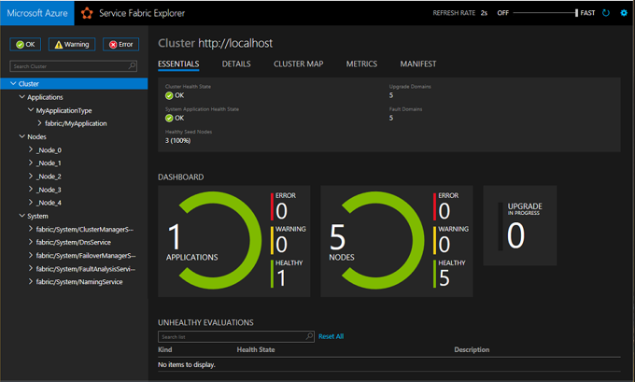
Continuous learning & monitoring
+ CorrelationId
Microservice
Logging
System
Application monitoring
+ Drill-down into microservice
Notes:
SPEAKER NOTES:
Business processes usually span multiple microservices. Since each microservice individually performs logging, a logging system is required to aggregate them. Use a CorrelationId known by all microservices to identify the instance of your business process. This helps you especially during error tracking and mitigation. Also the application monitoring should allow you drill-down from system level to each microservices to identify the root cause of an error quickly. Azure for instance provides you with Azure Monitor and the screenshot of the dashboard is actually the one provided by Service Fabric.

Slide 20
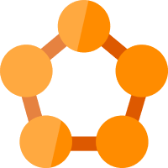
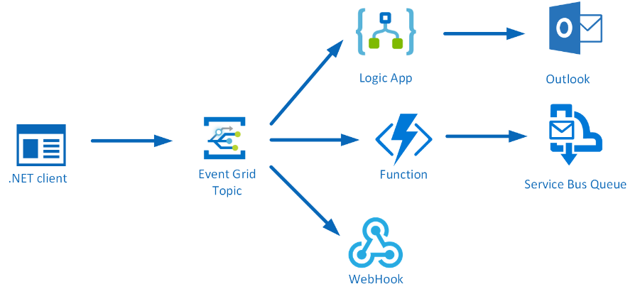




Hosting platform
Service Fabric
Kubernetes Service
Ecosystem
Modernize .NET applications to microservices using Windows Server containers
Scale and orchestrate Linux containers using Kubernetes
Bring your Partner solutions that run great on Azure
Container Orchestrator
Serverless
Notes:
SPEAKER NOTES:
Handling so much moving pieces in a microservice-based system, requires a proper hosting platform to orchestrate your workloads. Virtual machines require too much handcrafting and you cannot achieve high density and infrastructure utilization due to port exhaustion. Embracing containers and/or serverless is a way better solution to abstract the operational complexity. With containers, you basically package your application in a Docker container and run it on a container orchestrator like Kubernetes. This approach also helps you standardizing your DevOps approach and your hosting platform, since the container is the common denominator. They are especially helpful when modernizing existing applications in a brownfield approach, since containers can run on-premise and in the cloud. Again Azure provides you with a lot of choices here – i.e. Azure Kubernetes Service, Service Fabric, Service Fabric Mesh, RedHat OpenShift and Pivotal Cloud Foundry. When starting from greenfield, you might go even one abstraction layer higher and embrace serverless by using Azure Functions, Logic Apps and Event Grid. With serverless applications you only ship the code and do not worry about the infrastructure at all.

Slide 21
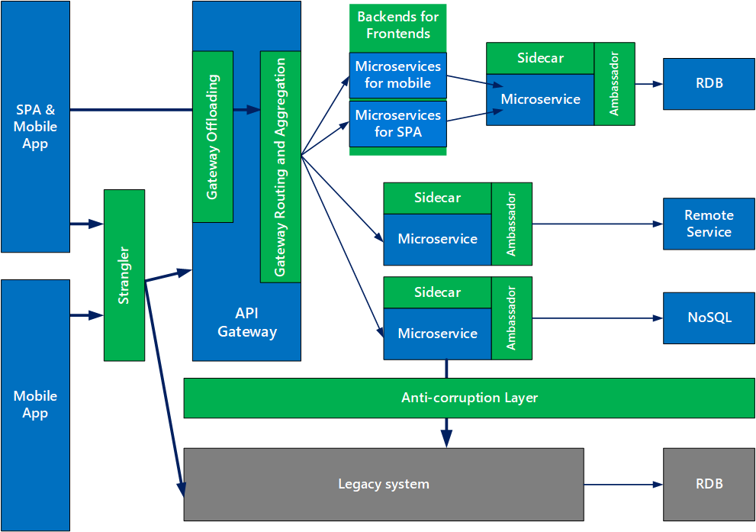
Ramp-up
Consider microservices for:
Apps with many subdomains
Scaling towards multiple teams
Require high release velocity
Require granular scalability
Notes:
SPEAKER NOTES:
As we have seen, microservices are no silver bullet. Microservices are solving organizational problems by introducing technical challenges. They follow a rather holistic approach so they can evolve individually, basically by aligning business, services and team boundaries. Following they are great for apps with many subdomains, when scaling towards multiple teams, if you require a higher release velocity or a more granular scalability. In order to compensate the technical challenges coming with it, you might rely on a mature and well-engineered platform like Microsoft Azure.

Slide 22


Additional resources
Microservices architecture style
Designing, building, and operating microservices
Design patterns for microservices
Microservice Guide
Microservices
Notes:
SPEAKER NOTES:
Finally, take a look at this links to further deep-dive into microservices. Also, look into related topics like DevOps, Containers and especially Azure. Happy coding.

Slide 23

Thank You

